Slide 1

Gatorscribe
A real-time music transcriber

Slide 2
Idea
Robust solution to transcribing a monophonic composition played from any instrument or voice
Designed to be a plug-and-play product for any experience level
Provides customization for song title, key signature, time signature, BPM, and playback instrument

Slide 3
Goals
Achieve monophonic pitch detection for the fundamental frequency of any instrument or voice
Create a simple user interface using a touch screen LCD
Automatic file transfer of MIDI file generated for display and playback of the transcribed sheet music

Slide 4
Block Diagram

Slide 5
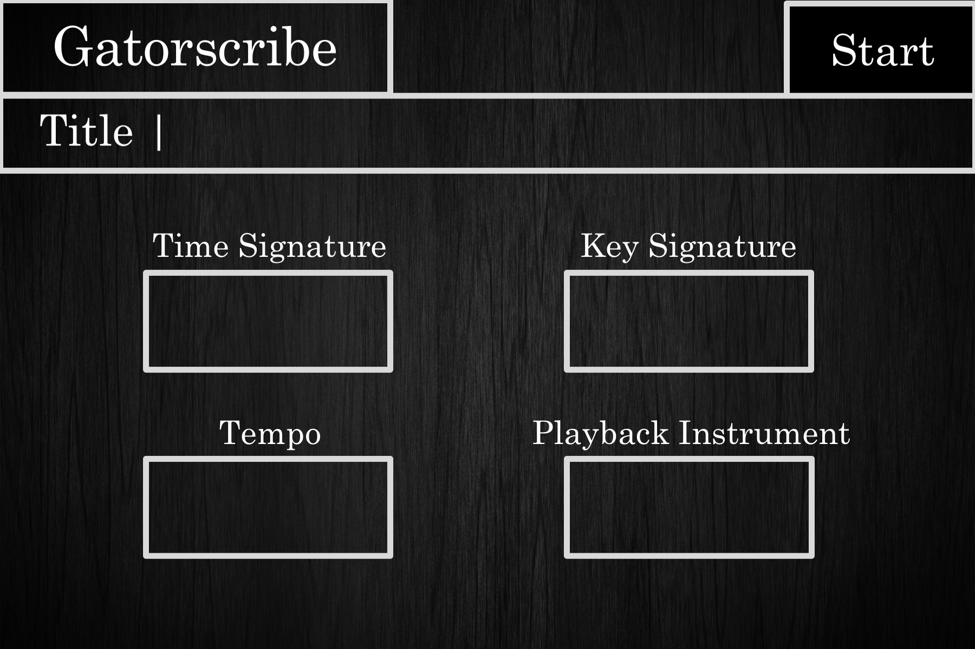
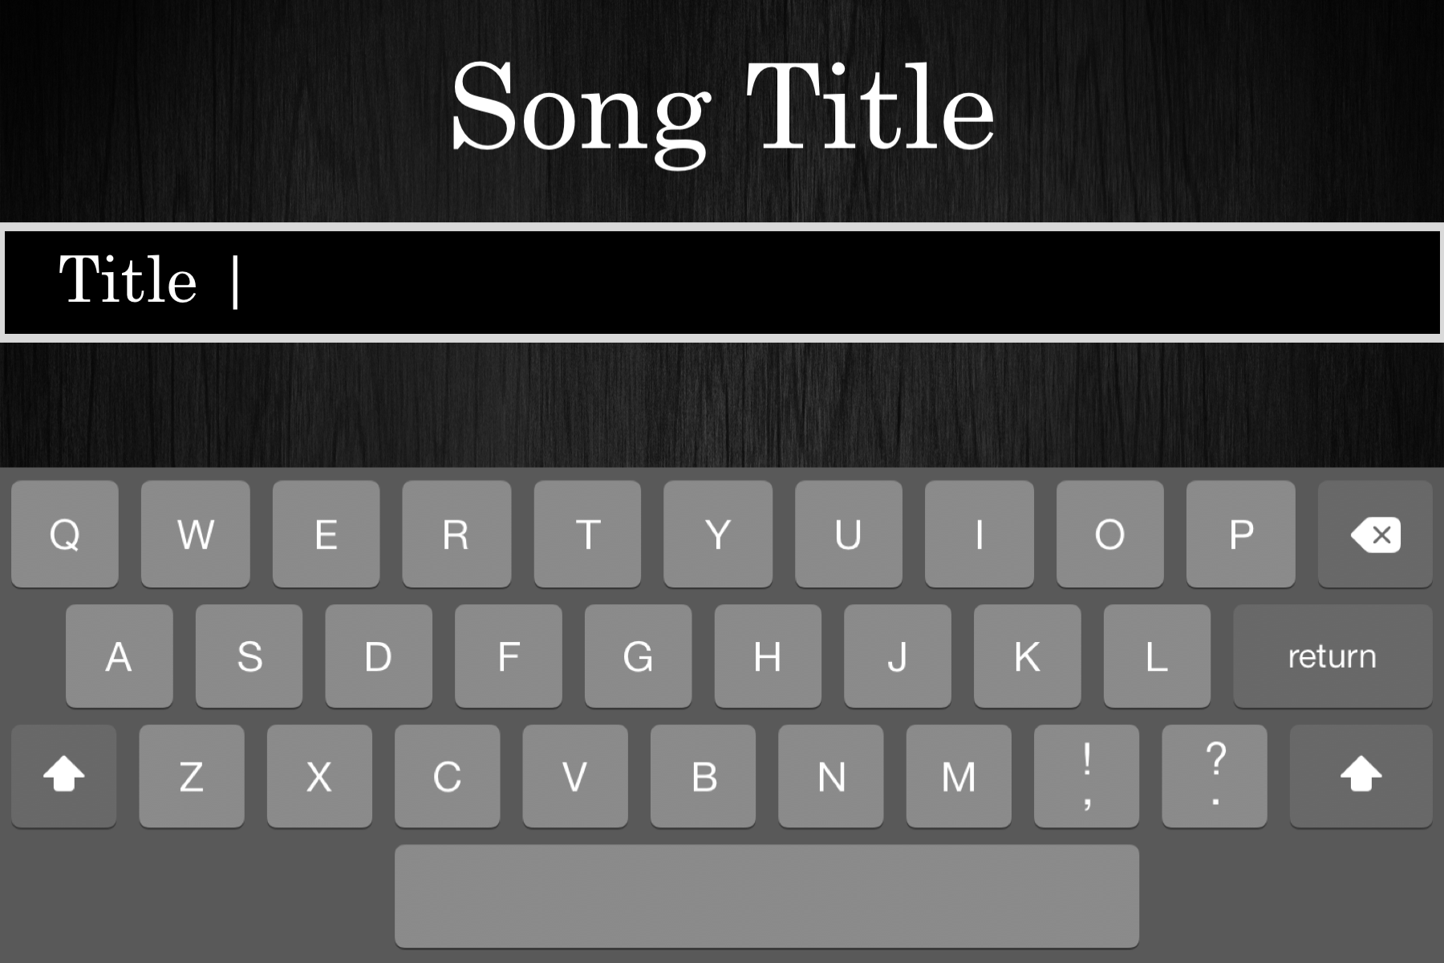
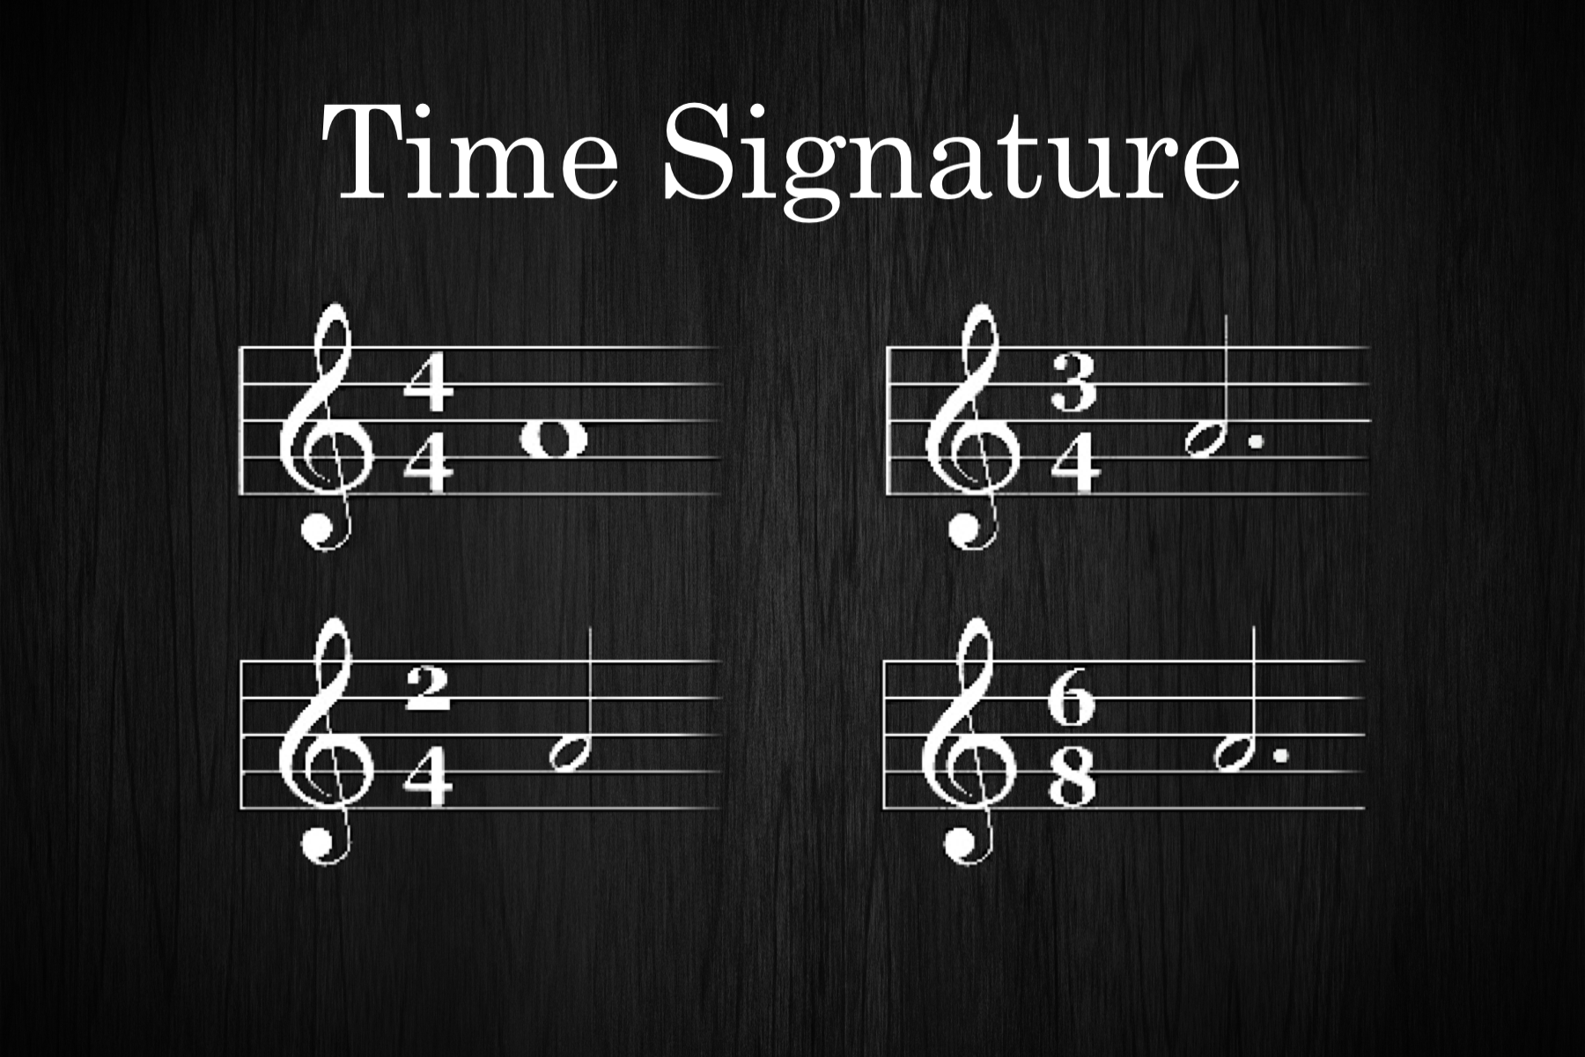
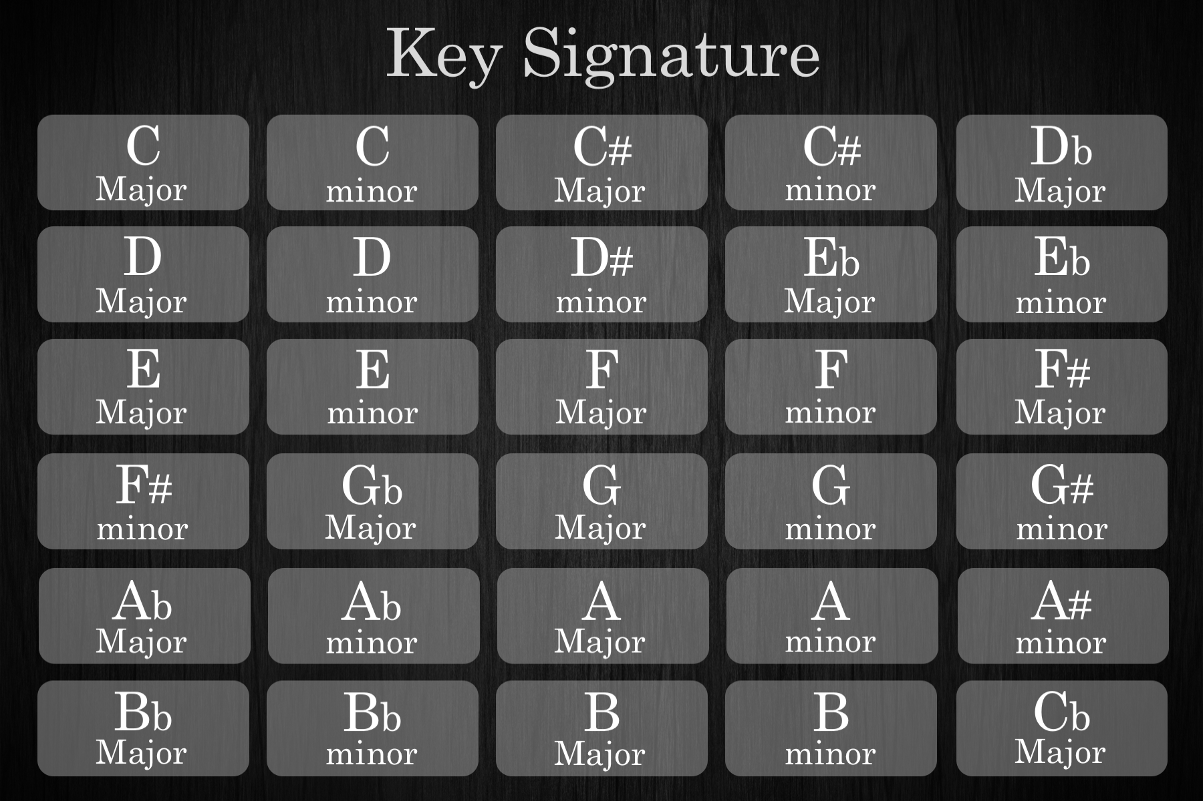
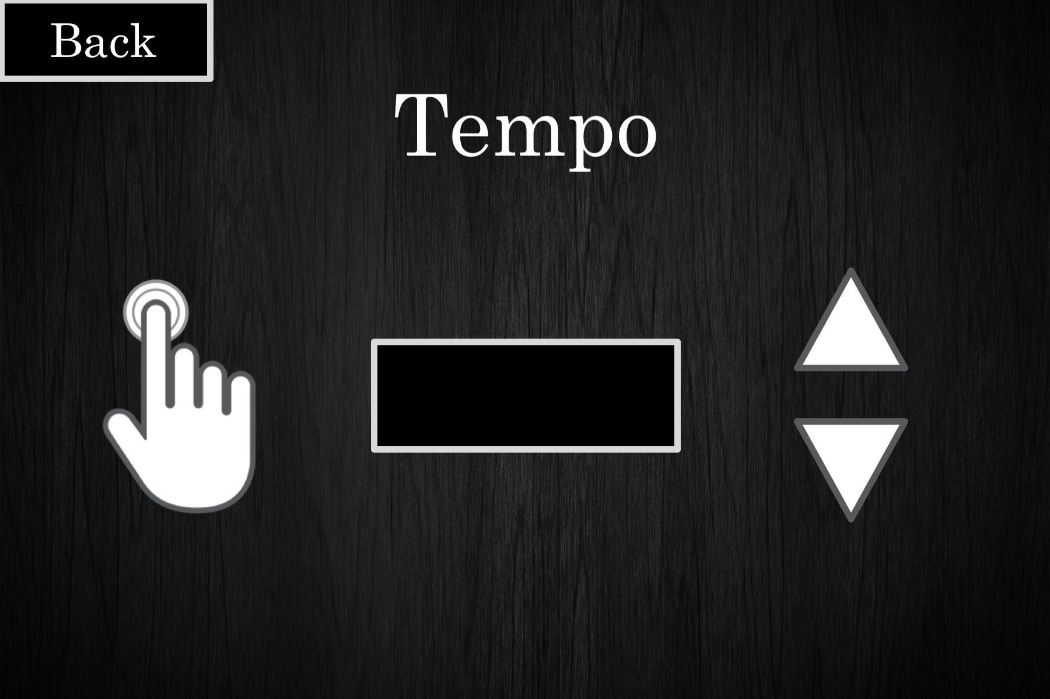
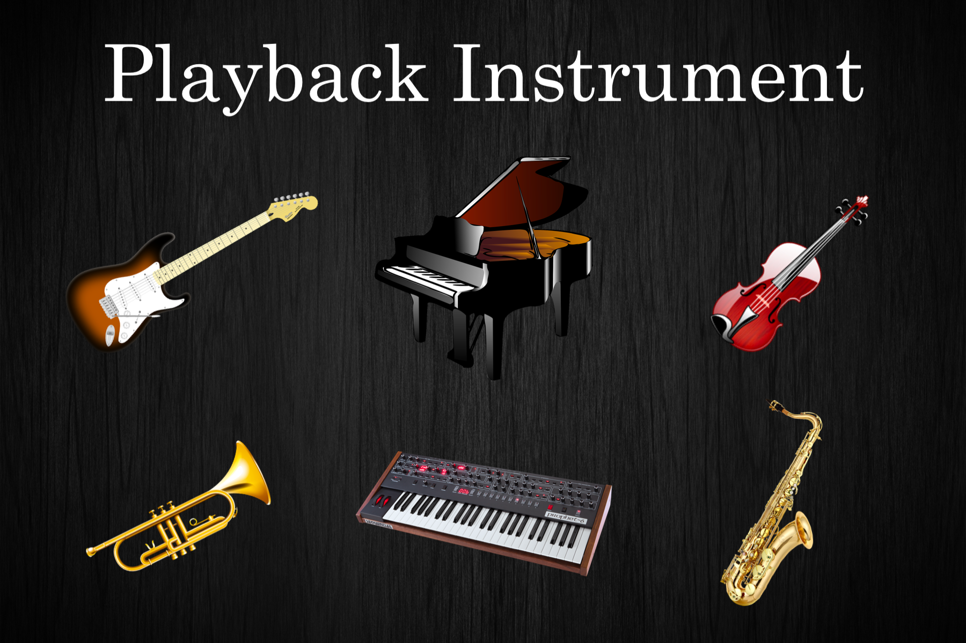
User Interface

Slide 6
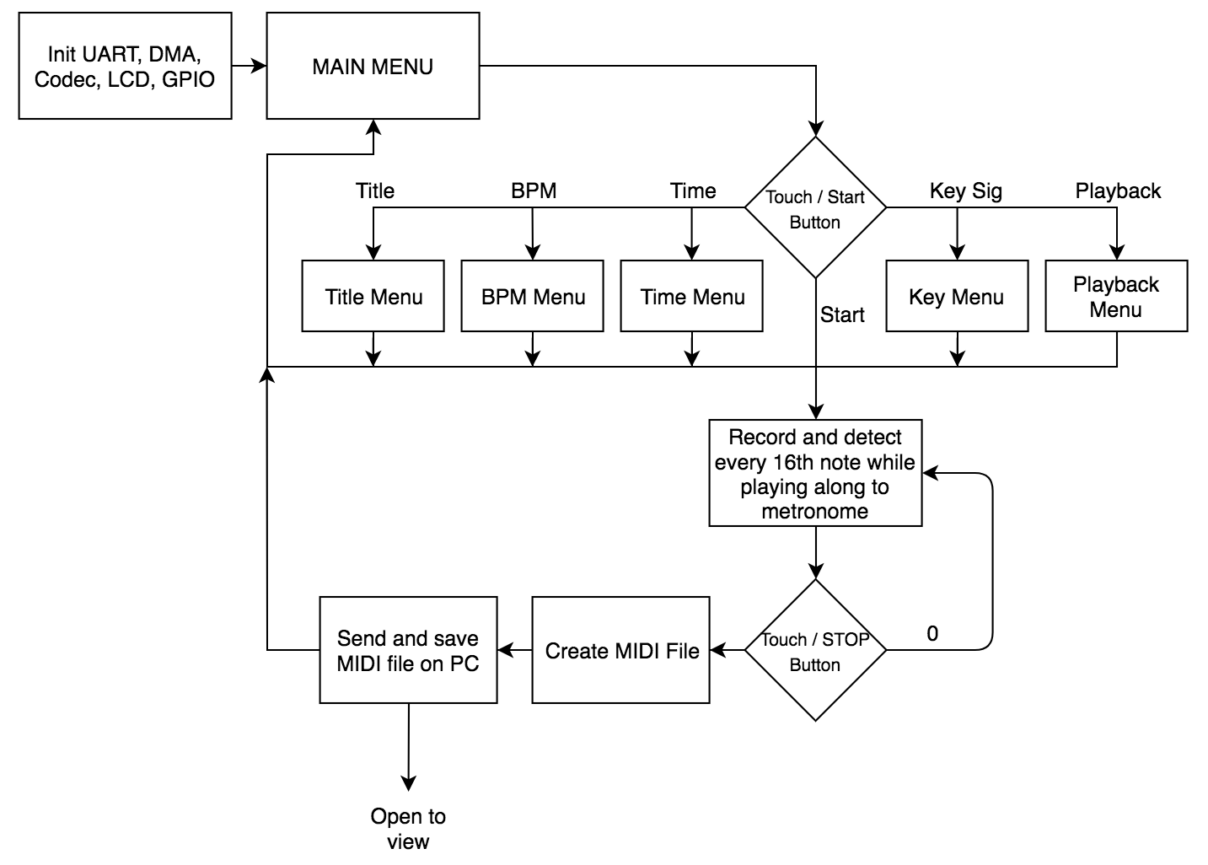
Flowchart

Slide 7
Demo
Showcase successful transcription from different instruments
Demonstrate user interface using touchscreen LCD
Perform automatic file transfer from board to computer through USB
Display and playback transcribed sheet music on computer monitor

Slide 8
Responsibilities
Danny
DSP
Pitch Detection
MIDI Transcription
Automation script
Altium
GUI Design
LCD
Tyler
Altium
GUI Design
Audio Amplifiers
Solidworks
Foot switches

Slide 9
Stretch Goals
Polyphonic music transcription
Java application for user interface as opposed to LCD

